Slide 1

Tune Clairvoyant
A Music Recommendation App
CAPSTONE TERM I
AIDI Fall 2021 Section B
2021-10-06

Slide 2

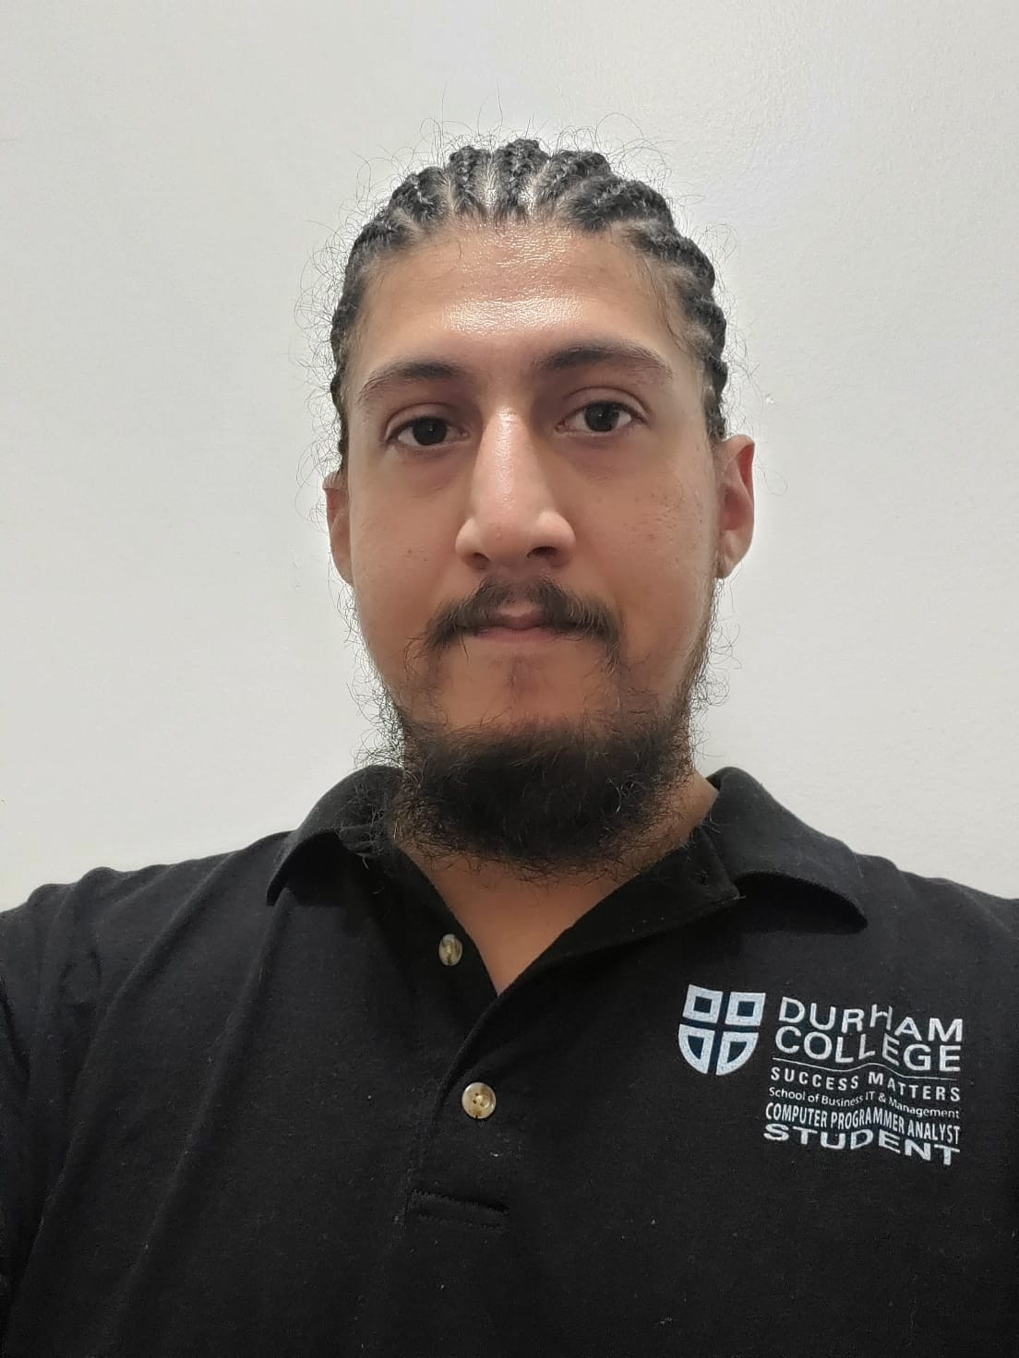
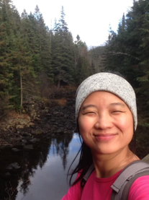
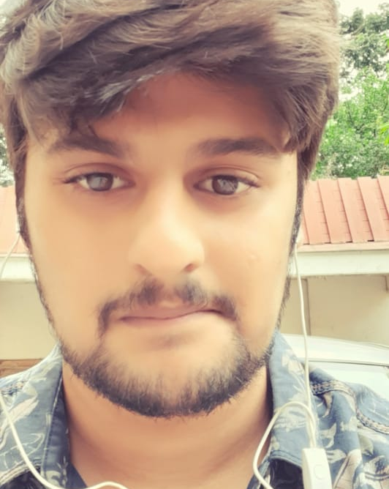
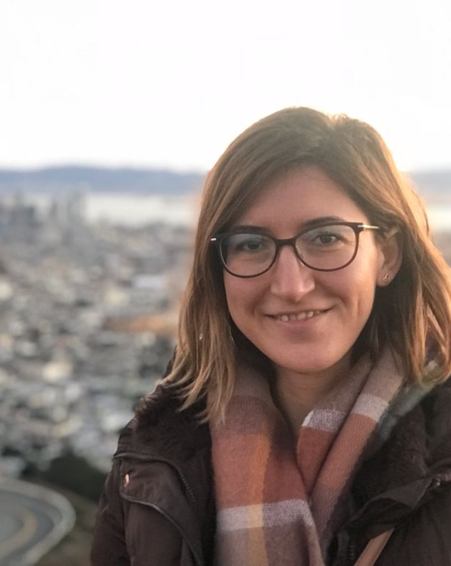
Meet Our Team
Joseph Mendez
Ariel Chen
Shrijit Pendse
Esra Ersoy
I am a CPA graduate from Durham College, with honours.
With experience with Riot Radio at the Oshawa campus, I look forward to completing this capstone project!
From Taiwan
Entry level programmer
Like memes, hike and swim
I have a Bachelor’s degree in Electronics and Telecommunications and a PGDM in Data Analytics.
My bachelor's degree is in Mathematical Engineering. And I worked as business analyst in software development projects in Turkey.

Slide 3

Project Definition
SCOPE
TOPIC
Build an application that is powered by AI - A real solution of music recommendation system. Our objective is using AI agents and algorithms to provide the end user with music suggestions they will enjoy. Based on users’ feedback, interaction and users’ profile, AI agents will learn and narrow down the next push to provide a more accurate suggestion.
TECHNOLOGY
NEXT STEPS
Spotify user dataset (Data source)
Python (AI model programming)
Azure (Cloud service)
Github (Version control)
Python - Django (User interface)
1. Familiarize with potential technology
2. Design framework for pages
3. Define database
4. Develop AI agent
5. Define use cases

Slide 4
Project Definition
SCOPE
MUST HAVES:
☑ A simple login page with a form in order to collect user information. (info like gender, name, age, location, interested type of music, etc.) (Not password field type of login/logout)
☑ A Search Box to enter the song name, artist, genre or lyrics to be found.
☑ Selected song from search results will be played on website OR will be directed to Spotify.
☑ AI agent to recommend songs based on;
User profile (country, interested music types etc.)
User execution (played songs.)
☑ A Results Section to list the recommended results.
NICE TO HAVES:
⬜ A section to type/pick mood, feeling, weather (ex: Happy, Melancholic, Energetic, Cloudy, Rainy, Sunny etc.) based on which songs will get recommended
⬜ LIKE or DISLIKE icons next to the suggested tracks in order to feed our data for ML model improvement purposes. ⬜ Algorithm to include time played vs length of song

Slide 5
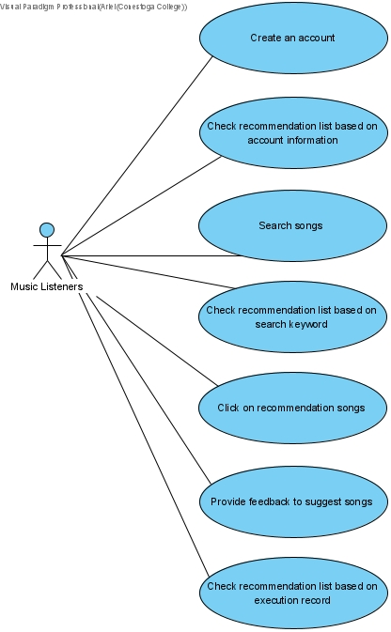
Project Definition
USE CASES

Slide 6

User Input
User Interface
Dataset
AI Model

